Slide 1
Deep Learning for Recommender Systems: An Applied Approach
TensorFlow Recommenders
Project: Amazon Product Recommendation System
Shahzaib Hamid

Slide 2
Overview
Overview of TensorFlow Recommenders
Retrieval Model – Two Tower Model for Recommendation Systems
Hands-on: Project: Amazon Product Recommendation System using TensorFlow Recommenders

Slide 3
Overview of TensorFlow Recommender
An Open-Source Library to build recommender systems
Build and Evaluate Flexible Recommender Systems
Driven by Practical Needs
Incorporates Results on
  Multi-task Learning
  Feature Interaction Modeling
Easy to Use
Based on Two-Tower Model
Notes:
Due to increased number of data
Captures non-linear and non-trivial relationship between user and product

Slide 4
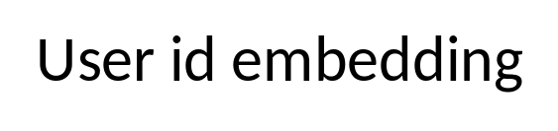
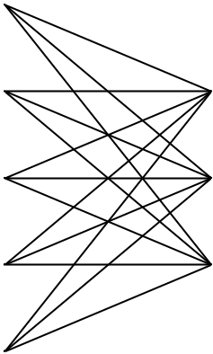

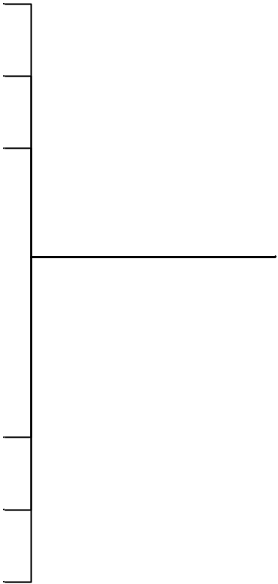
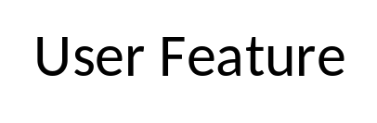
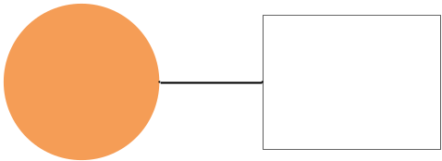
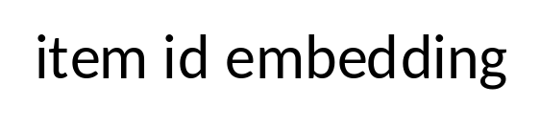
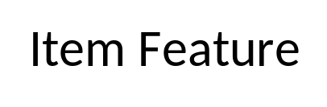
Two-Tower Model

Slide 5
In this project
Packages Installation
Data Preparation with Python
Recommender Development using TensorFlow
Model Evaluation
Product Recommendation

